Slide 1


Precipitation products comparison over European and African areas: methodology and data used
Marco Petracca, Silvia Puca
DPC (Italy)
Jan Kanak
SHMU (Slovakia)
and Quality Assessment Cluster
Marco Petracca

Slide 2
Outline
Quality Assessment activities (Q.A.)
Precipitation Product Validation Group (PPVG)
Precipitation products
Reference precipitation data
Validation Methodology (over Europe and Africa)
Results and conclusion

Slide 3

Quality Assessment activities
Validation activities have particular relevance towards end-users of the products.
There are two main requirements according to the specific use of the products:
1- the direct use by human operators monitoring in real time the Hydrological situation for taking decision
2- the direct use by hydrological numerical models to provide run off information
In order to accomplish such requirements, two dedicated clusters were designed to elaborate the direct end-user quality assessment service.

Slide 4
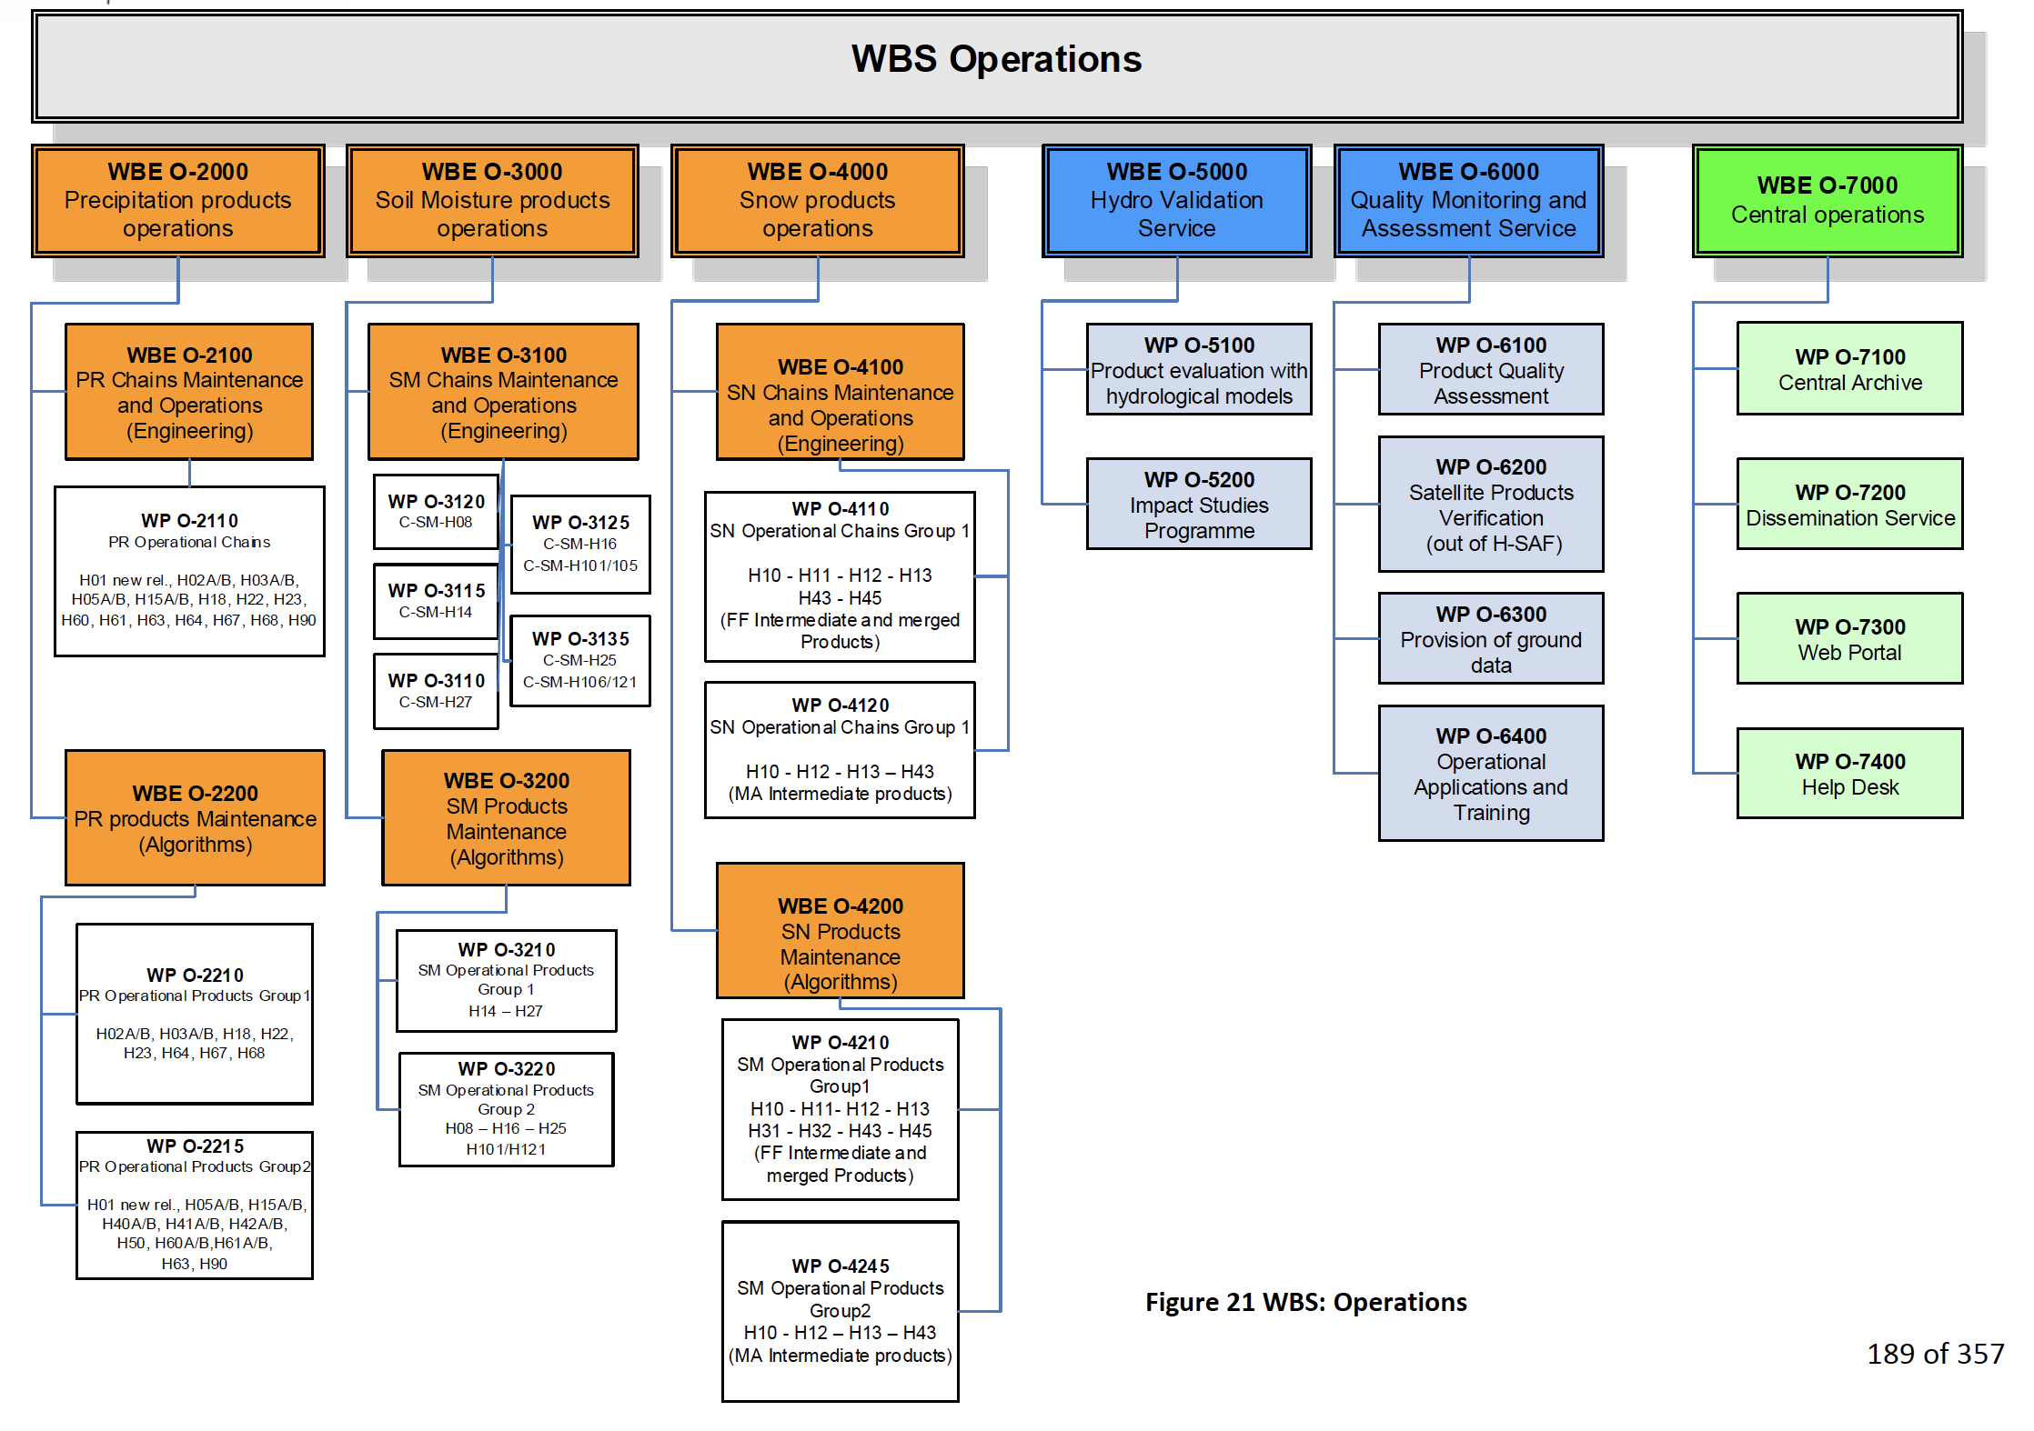
Quality Assessment activities
To assess the benefits of the satellite-derived data on practical hydrological applications
To monitor the product quality

Slide 5
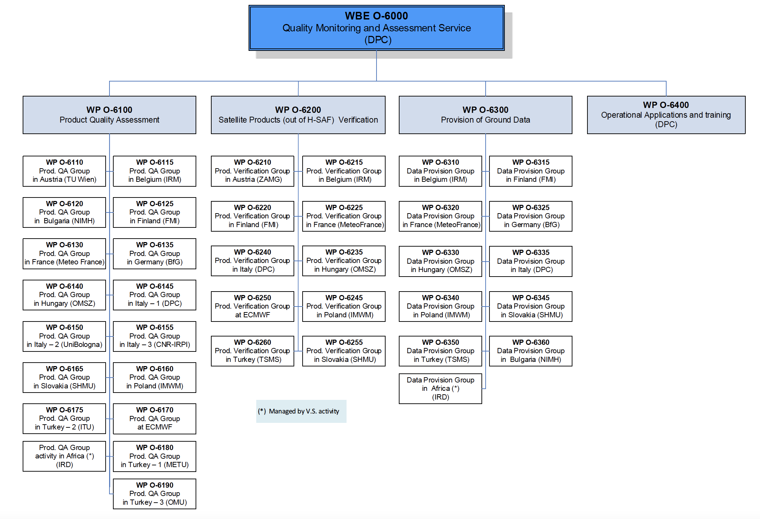
Quality Monitoring and Assessment Service
the Quality Monitoring and Assessment service is responsible to:
• monitor the progress in product quality;
• provide validation service to end-users;
• provide ground data service inside the project;
• investigate the H SAF product impact in end-user applications.
The cluster is coordinated by the Italian Civil Protection Department (DPC)

Slide 6
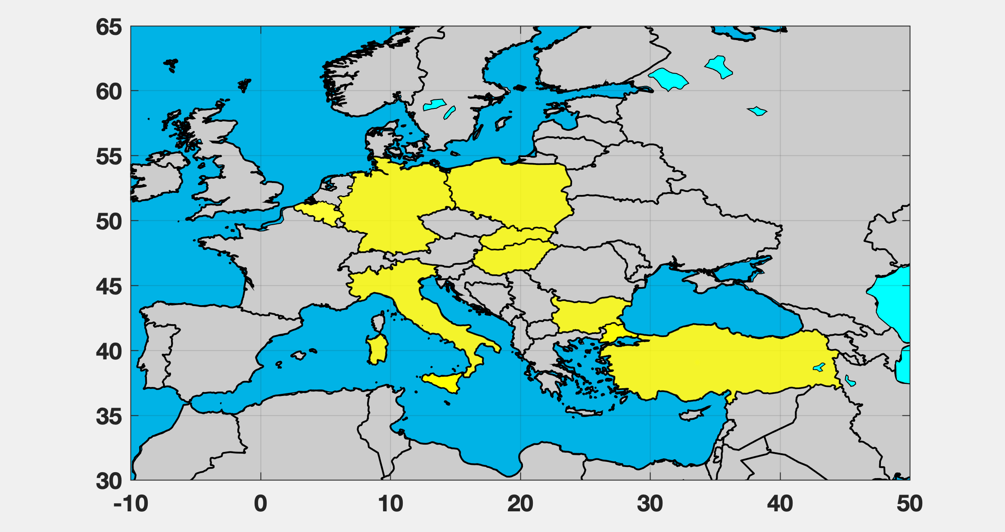
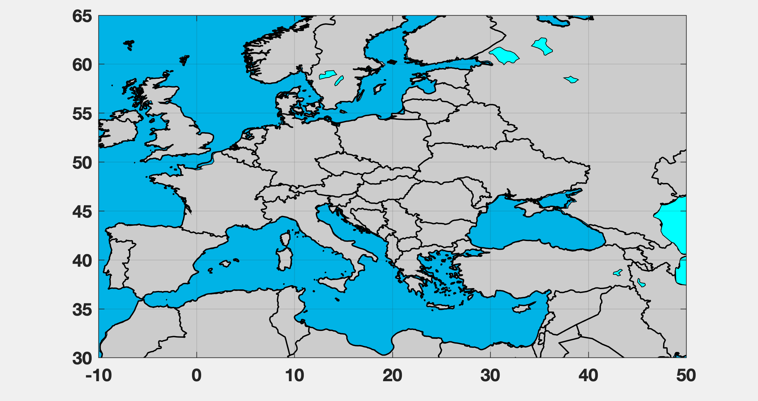
Precipitation Product Validation Group (PPVG)
The Precipitation Product Validation Group (PPVG) is composed of experts from the National Meteorological and Hydrological Institutes of 8 European countries. The PPVG uses ground data for quality assessment of precipitation products, following the same methodology.
Country | Institutes
Belgium | RMI
Bulgaria | NIMH
Germany | BfG
Hungary | OMSZ
Italy | DPC, UniBo
Poland | IMWM
Slovakia | SHMU
Turkey | ITU, METU,TSMS

Slide 7
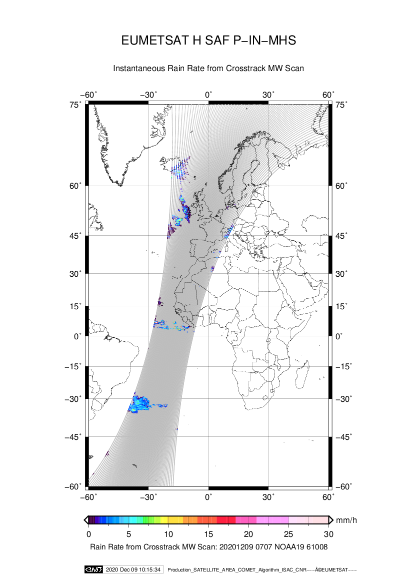
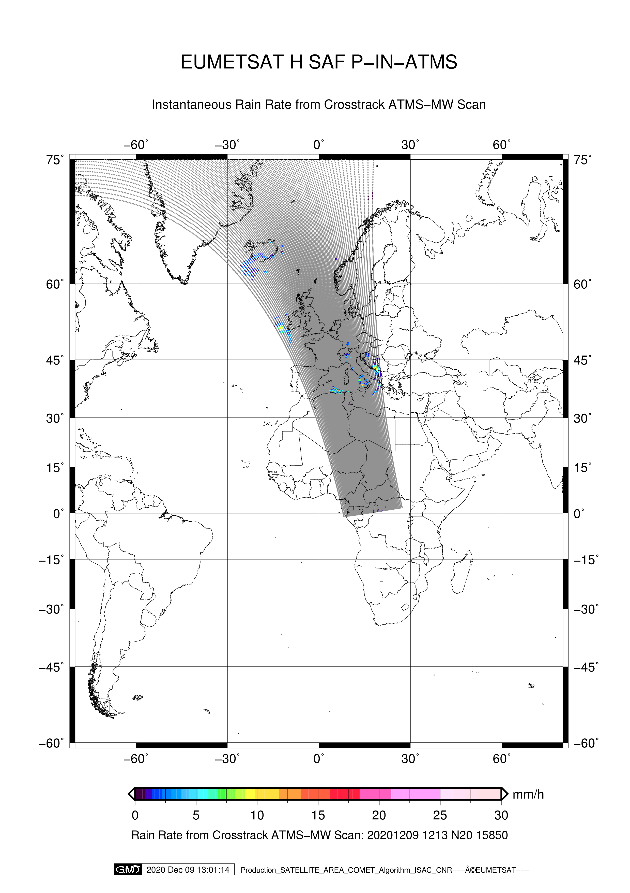
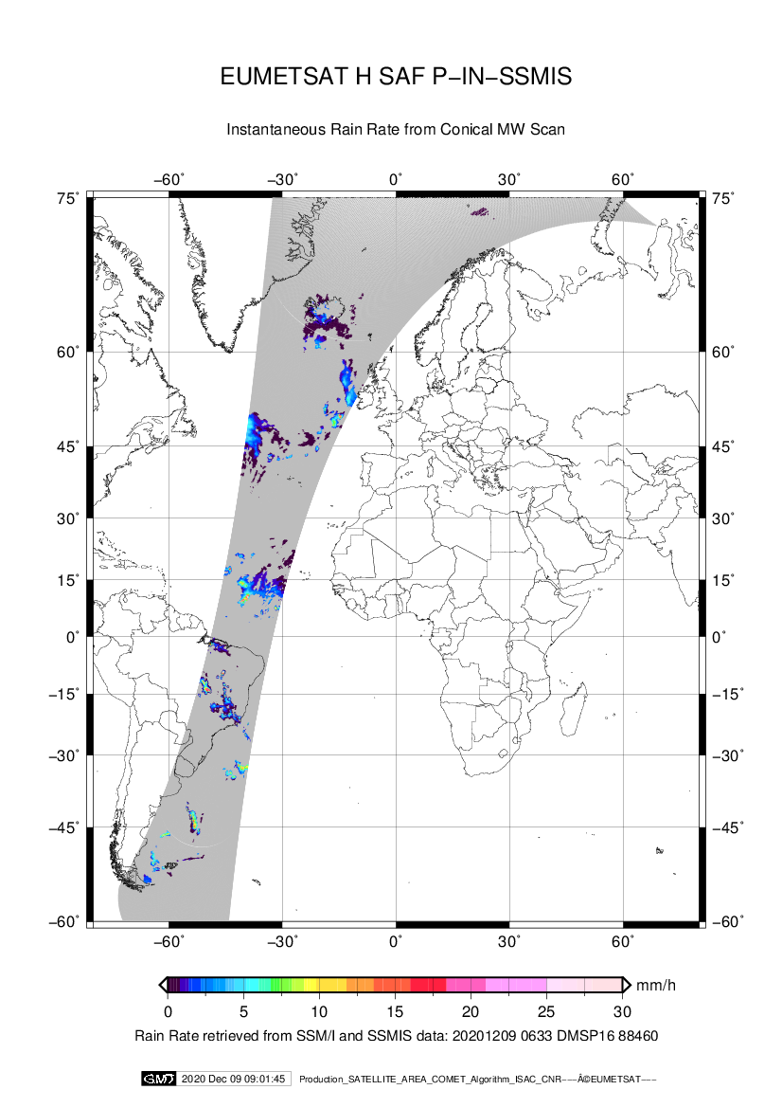
Op Precipitation Products PMW-based
H01
H02
H18
physically-based Bayesian approach
Neural network approach
Dissemination via EUMETCAST
NetCDF
 | H01 new rel. (P-IN-SSMIS) | H02B (P-IN-MHS) | H18 (P-IN-ATMS)
Coverage | Strips of ~1700 km swath crossing the MSG 0° extended Full Disk area | Strips of ~2250 km swath crossing the MSG 0° Full Disk area | Strips of ~2250 km swath crossing the MSG 0° extended Full Disk area
Cycle | Up to 6 passes/day | Up to 8 passes/day | Up to 4 passes/day
Spatial Resolution | ~13.2 x 15.5 Km² (SSMIS 91.6 GHz channel resolution) | Corresponds to the nominal resolution of MHS, vaying from 16 x 16 Km² to 26 x 52 Km² | Corresponds to the nominal resolution of ATMS, vaying from 15.82 x 15.82 Km² to 26 x 52 Km²
Timeliness | 150 minutes from observing time | 30 minutes from observing time | 30 minutes from observing time

Slide 8
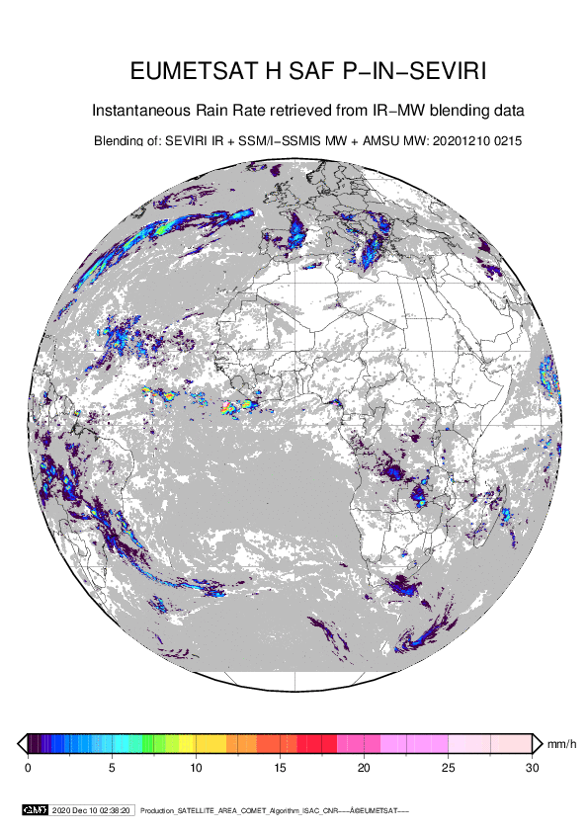
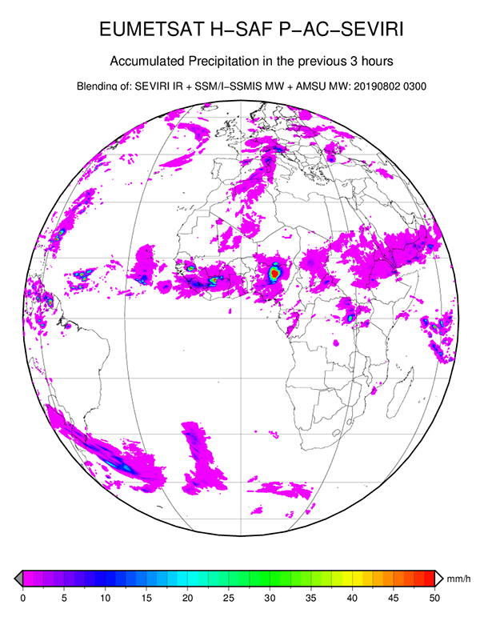
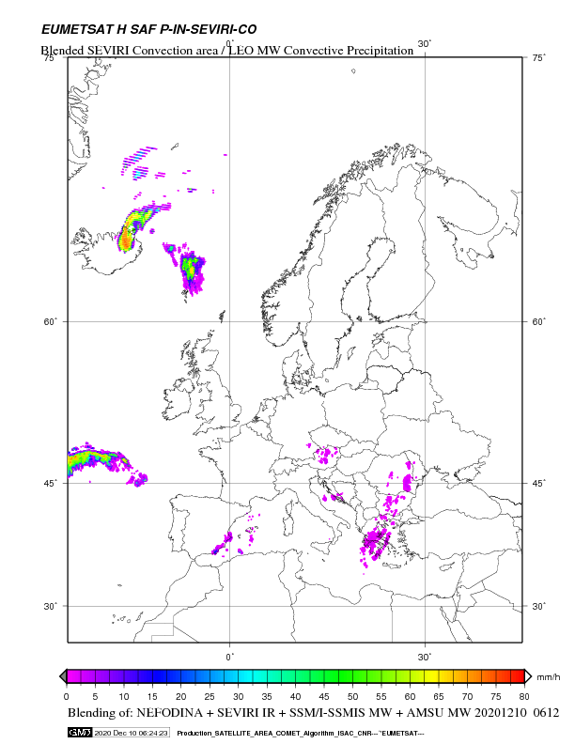
Op Precipitation Products SEVIRI-based
Blending technique
H03
H05
H15
Dissemination via EUMETCAST
NetCDF
 | H03B (P-IN-SEVIRI) | H05B (P-AC-SEVIRI) | H15A (P-IN-SEVIRI-CO)
Coverage | MSG 0° Full Disk area | MSG 0° Full Disk area | H SAF area extended up to higher latitudes
Cycle | 15 minutes – every new SEVIRI image | 3-6-12-24h cumulated every three hours | 15 minutes – every new SEVIRI image
Spatial Resolution | dependent of SEVIRI IFOV. In average: Res 8 Km; Sampling: 5 Km | dependent of SEVIRI IFOV. In average: Res 8 Km; Sampling: 5 Km | dependent of SEVIRI IFOV. In average: Res 8 Km; Sampling: 5 Km
Timeliness | within 15 minutes from the end of acquisition | 15 minutes after synoptic hours (0-3-6...21 UTC) | within 15 minutes from the end of acquisition
Marco.Petracca@protezionecivile.it (DPC)
8

Slide 9
Operational Precipitation Products
? When and how are the products validated ?
Operations Readiness Review (ORR)
Operations Review (OR)
Operation Readiness Review (ORR) aimed to assess the validation result and readiness to deliver the Products
The Operation Reviews (OR) yearly planned involves all the operational / pre-operational products.
The transition from “In development” to ”Pre-operational” to “Operational” is gradual, as long as sufficient validation becomes available. Related milestones and processes (reviews) are organized depending on the progress.

Slide 10
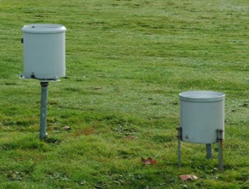
Validation over Europe
European area
European ground data:
radars and raingauges

Slide 11
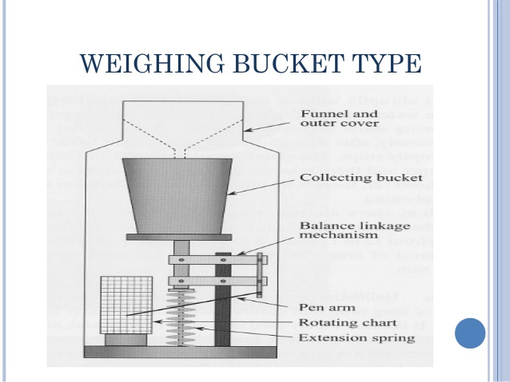
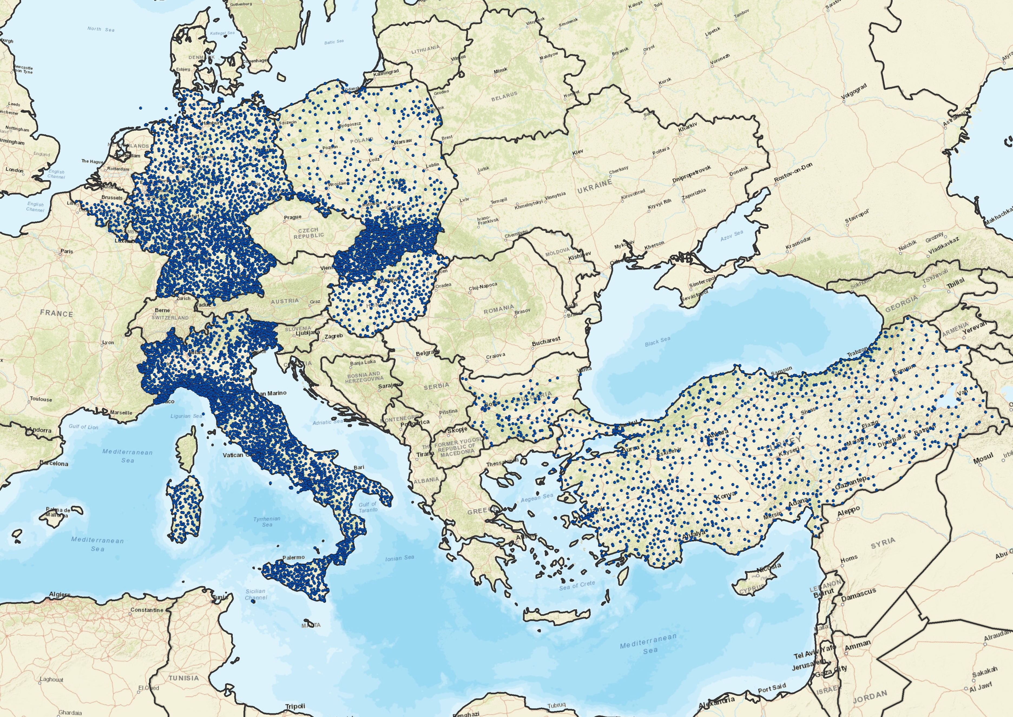
European ground data: raingauges
Most of the gauges used in the National networks by the validation Groups are of the tipping bucket type, which is the most common device used worldwide to have continuous, point-like rain rate measurement. The German network, and a part of the Bulgarian network, as an example, are equipped by precipitation weighing gauges, that allow continuous precipitation (both solid and liquid) measurements with higher accuracy.
Minimum detectable rain
≥ 0.1 mm
Typical time resolution
1 hour
Available output format
ASCII
Country | Total number of gauges | Average minimum distance (km)
Belgium | 92 | 15.2
Bulgaria | 123 | 25.2
Germany | 2299 | 12.9
Hungary | 270 | 17.0
Italy | 2934 | 11.3
Poland | 540 | 24.0
Slovakia | 911 | 13.6
Turkey | 1235 | 26.5
TOTAL | 8404
More than 8,000 rain gauges

Slide 12
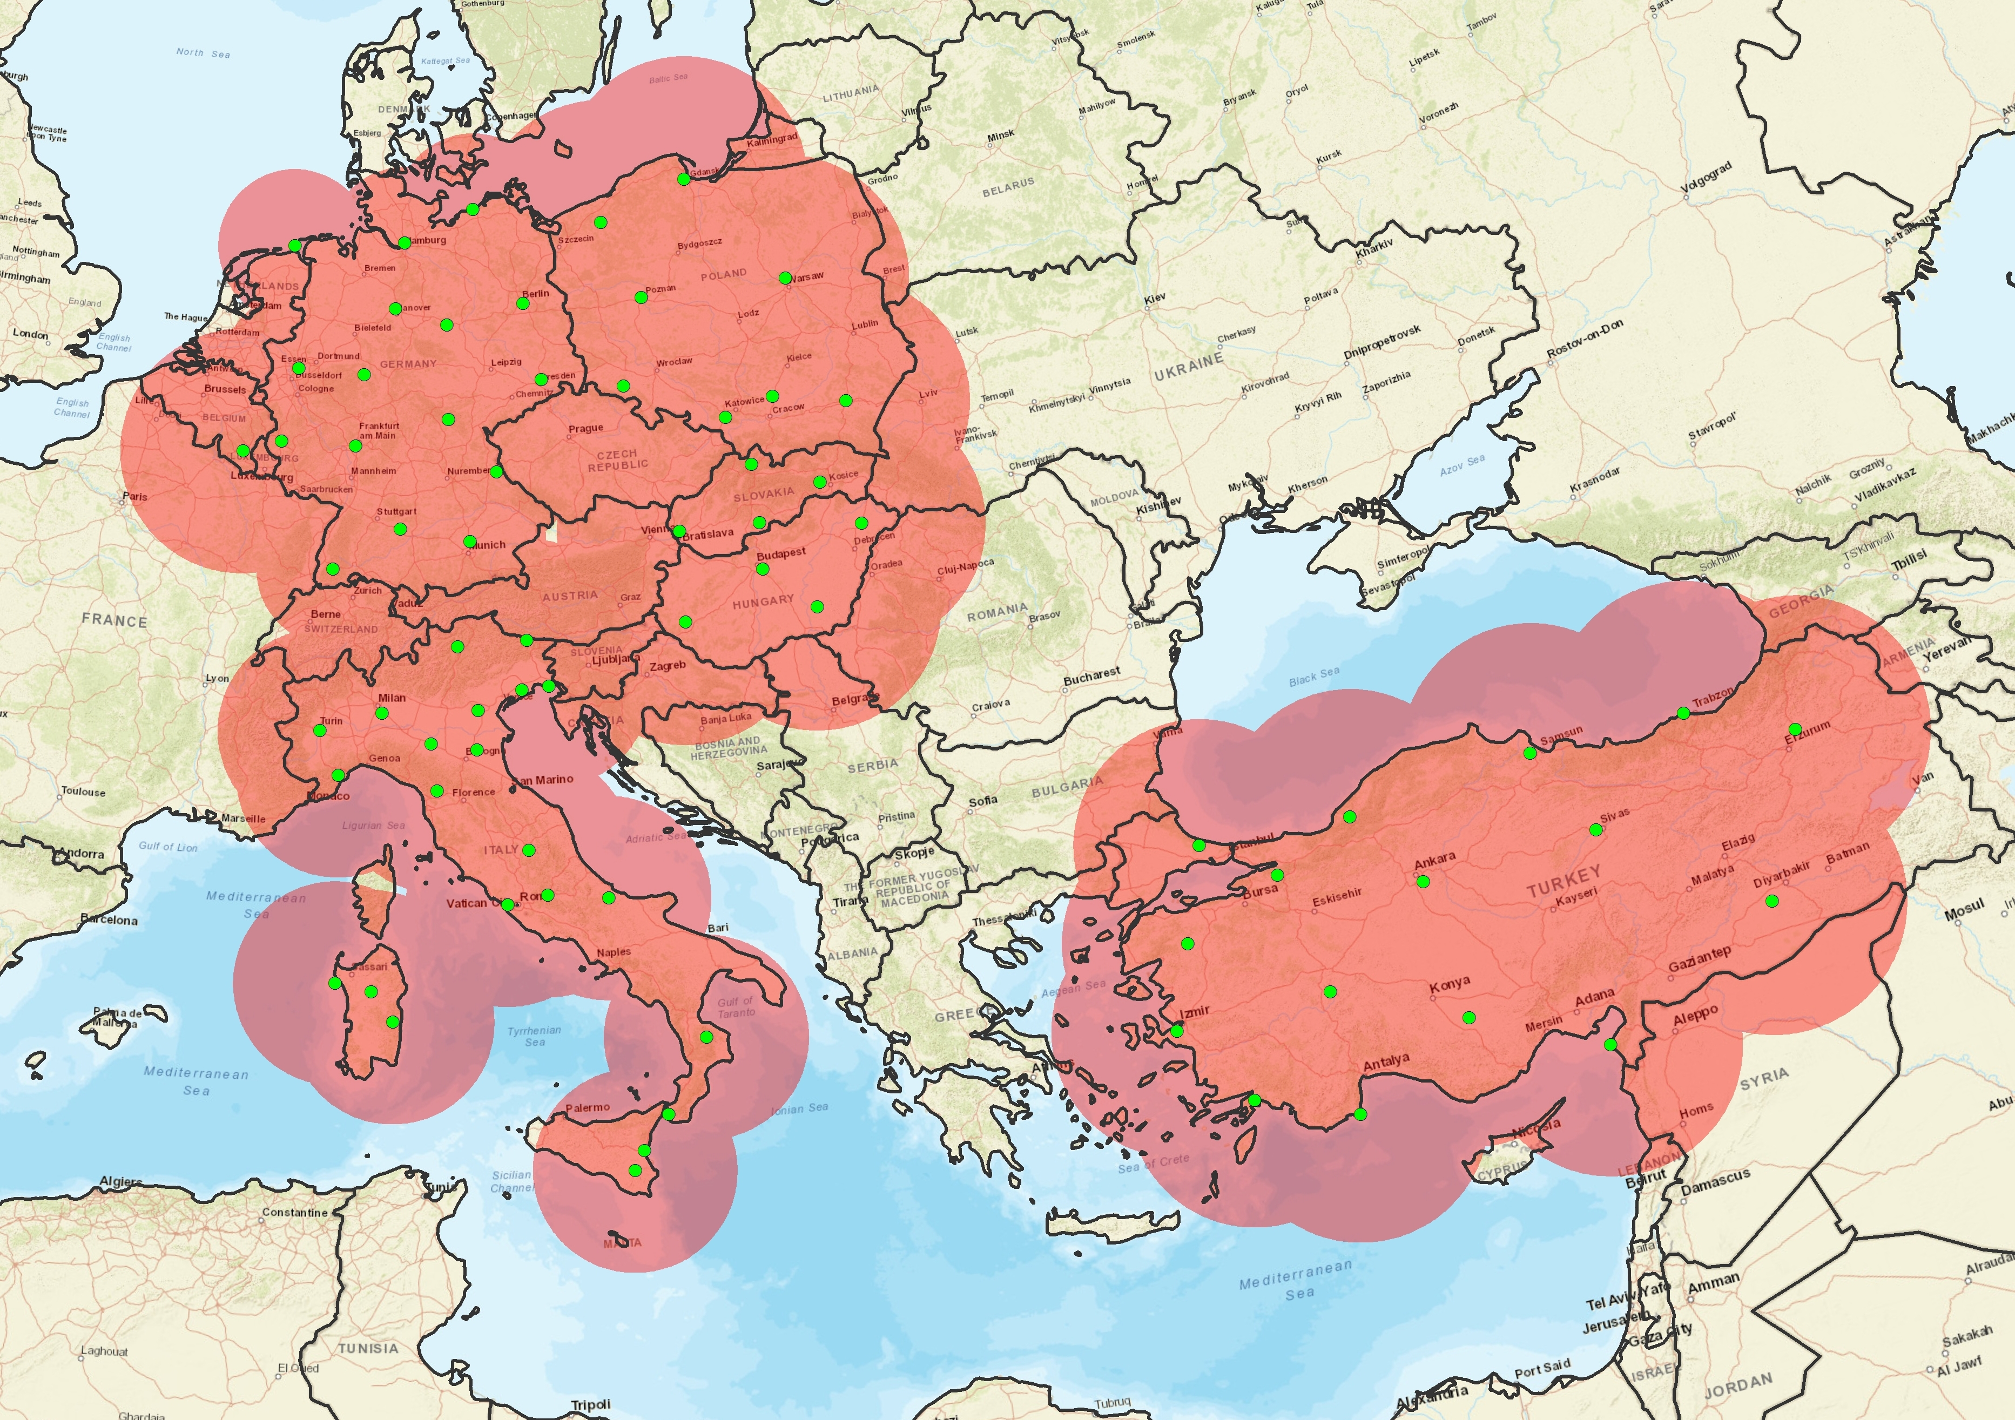
European ground data: radars
Minimum detectable rain rate
≥ 0.01 mm/h
Time resolution
5 – 60 minutes
Output formats
HDF5, NetCDF, …
Country | Total number of radar | Average minimum distance (km)
Belgium | 1 | -
Bulgaria | - | -
Germany | 16 | 163
Hungary | 4 | 190
Italy | 22 | 141
Poland | 8 | 186
Slovakia | 4 | 137
Turkey | 16 | 253
TOTAL | 71
71 C-band radars
Institutes involved in the PPVG declared the system are kept in a relatively good status and all of them apply some correction factors in their processing chain of radar data. Only the radar data which passes the Quality Check of the owner Institute are used by the PPVG for validation activities.

Slide 13

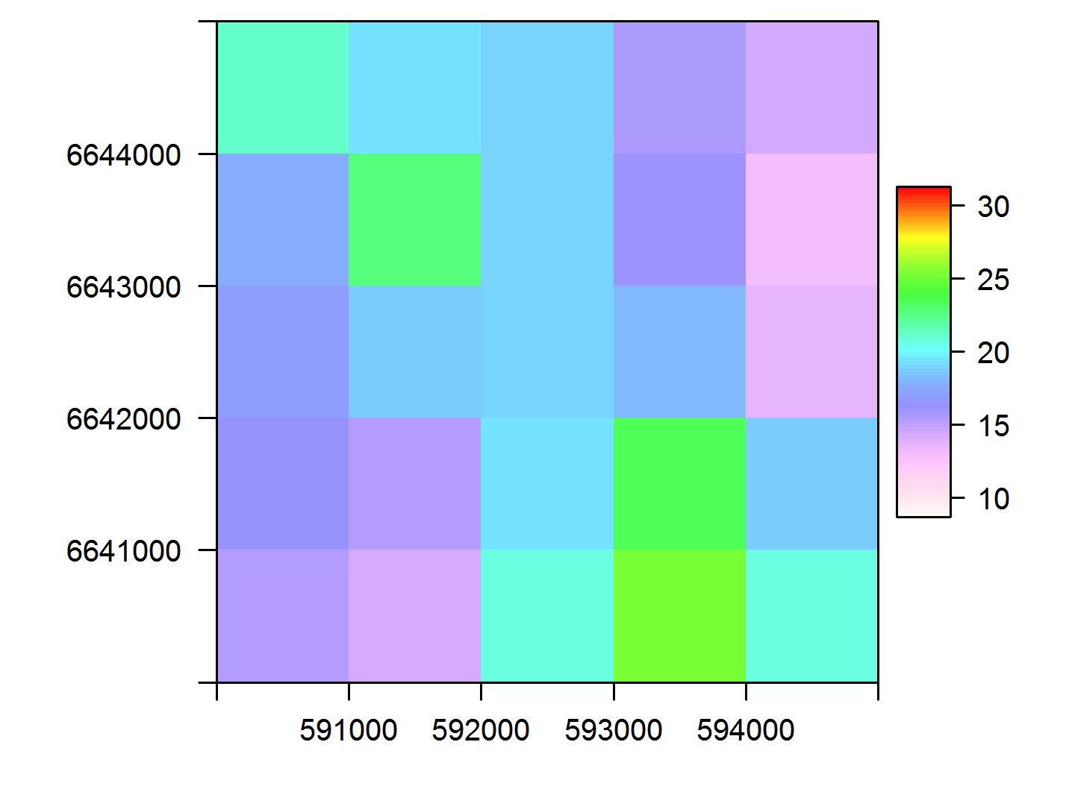
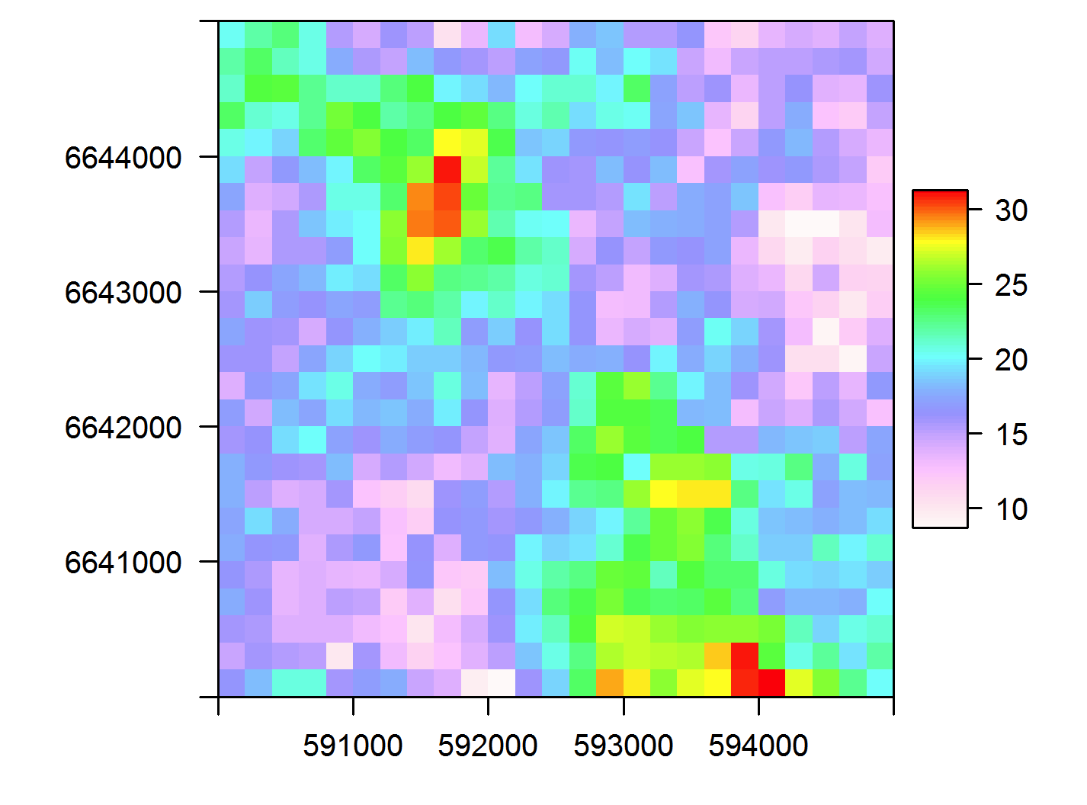
Validation methodology over Europe
1. GROUND DATA
2. TEMPORAL-SPATIAL MATCHING
<- the validation is performed over the satellite grid. Only the reference data is degraded and not the satellite data. This is to evaluate the product at the same resolution as the data released.
Quality check and filtering
Spatial interpolation (GRISO)
Upscaling to
the product grid
3. STATISTICAL (CONTINUOUS AND MULTI-CATEGORICAL) SCORES
Precipitation classes:
Light [0.25≤RR (mm/h) <1.0 ]
Moderate [ 1.0≤ RR (mm/h) <10.0]
Heavy [ RR (mm/h) ≥10.0]
All [ RR(mm/h) ≥ 1.0 ]
Surface types:
Sea
Land
Coast
Overall
Time intervals:
Monthly
Seasonal
Yearly
Precipitation phases:
Liquid
Solid
Mixed
All
This comparison methodology is performed by the Unique Common Code (UCC) for all (8) participating countries (PPVG)

Slide 14
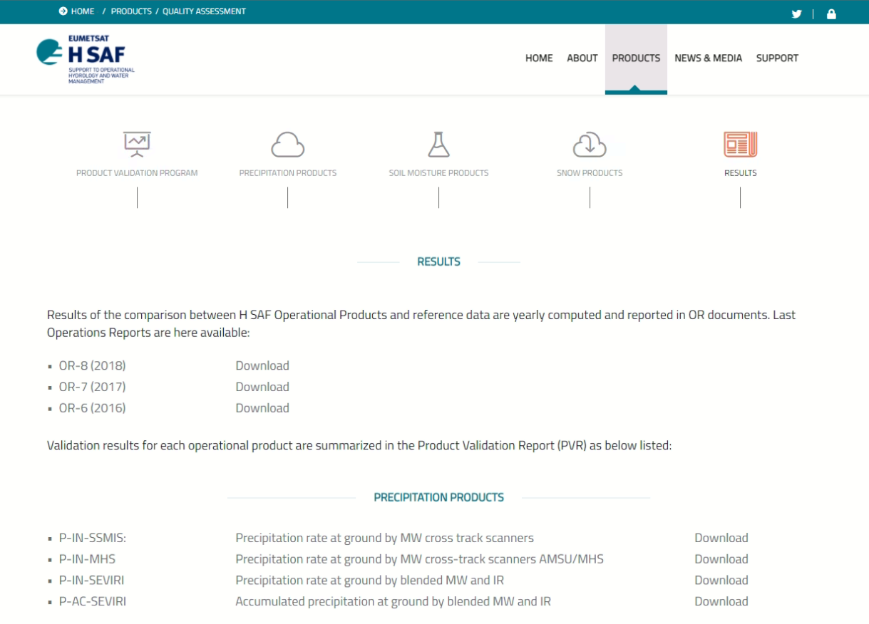
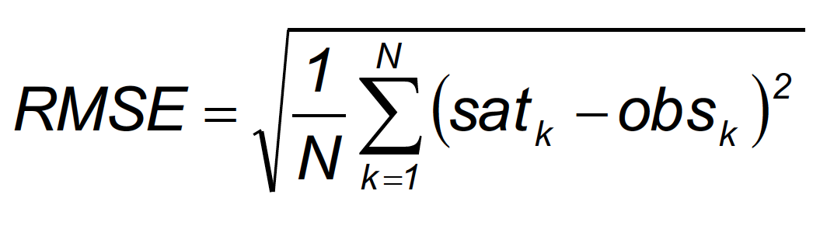

Summary results over Europe
How to objectively determine if a product satisfy User Requirements?
Fractional Standard Error (FSE) %
FSE = [RMSE / <obs>] *100%
REQUIREMENTS (FSE%)
OPTIMAL | TARGET | THRESHOLD
100 | 150 | 200

Slide 15
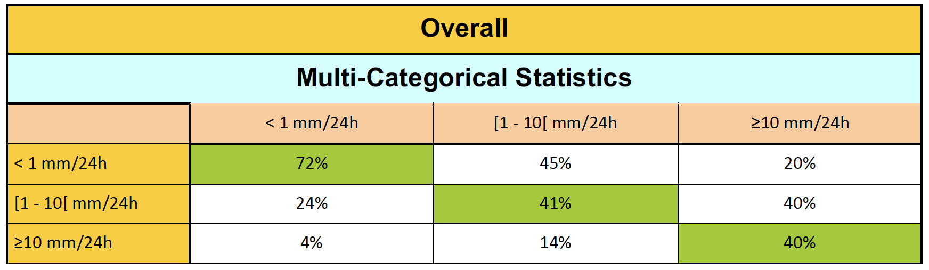




Summary results over Europe

Slide 16
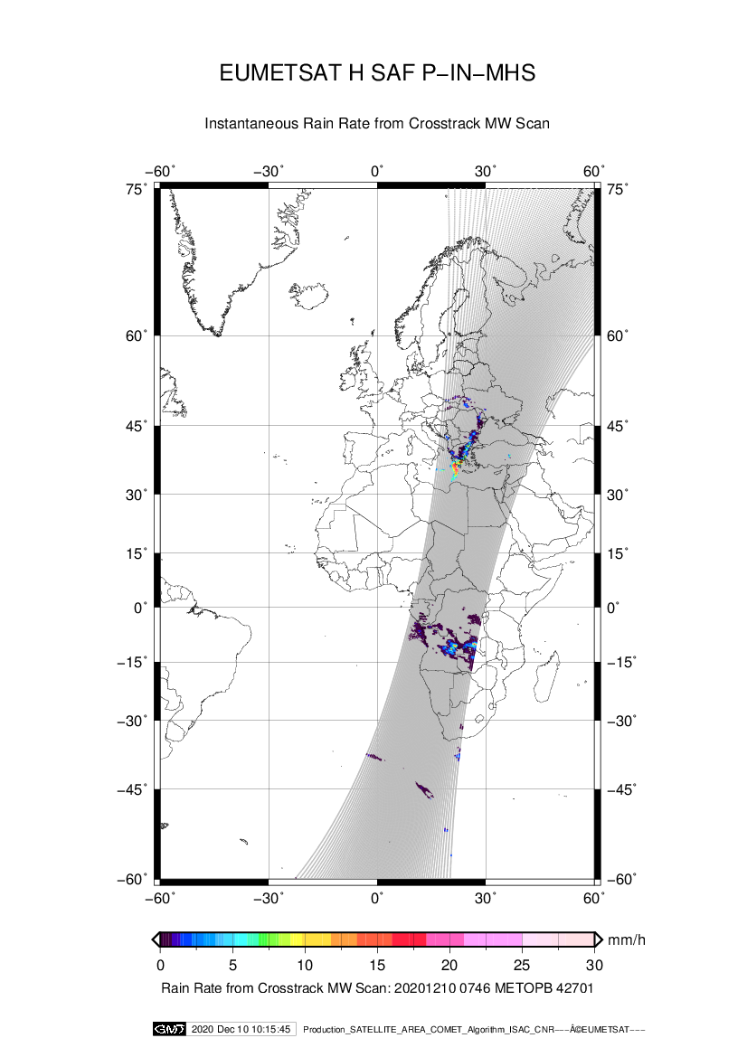
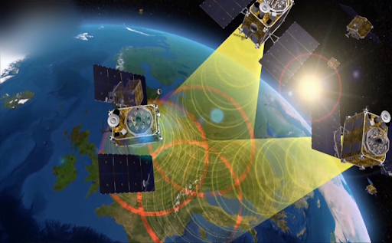
Comparison over Africa
African area
Satellites
Reference ground data:
radars and/or raingauges

Slide 17

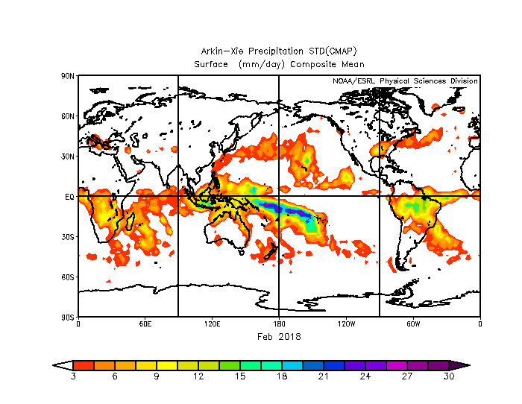
Available precipitation data over Africa
Few gauges, very few weather radars
Non-homogeneous extension over the whole Africa
Daily or monthly data of climatological interest and not hourly or sub-hourly
Precipitation datasets not independent by the products to be validated
Data only on land areas

Slide 18
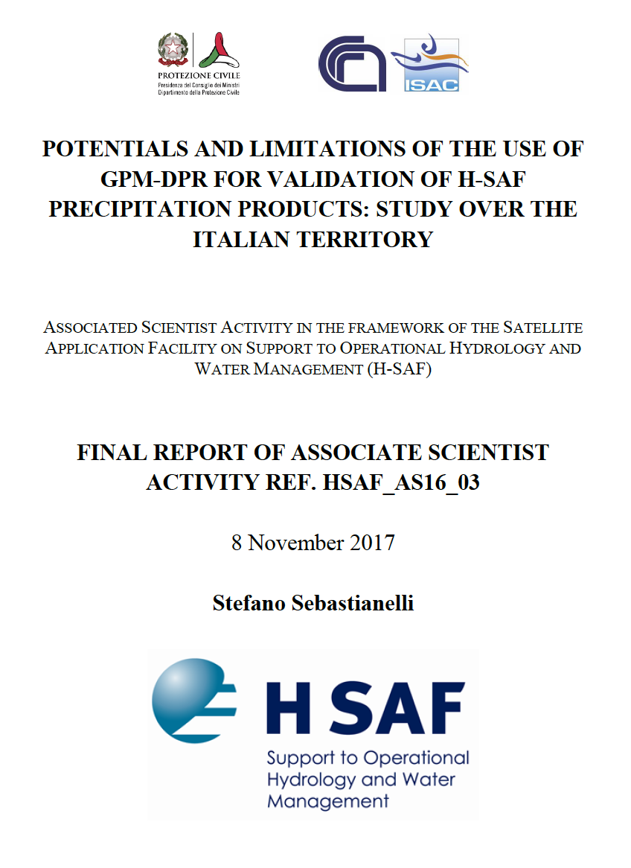
Associate Scientist activity result
«…it can be establish that 2A-DPR NS V05 can be used to verify the H03 (P-IN-SEVIRI) rainfall estimations where the ground radars are not available, as is the case for most of the African territory. This is more true for light to moderate precipitation, whereas for heavy precipitation DPR products should be used with more caution, due to the underestimation of DPR with respect the reference and to the scarce data of heavy precipitation sampled by the ground-based radars.»

Slide 19
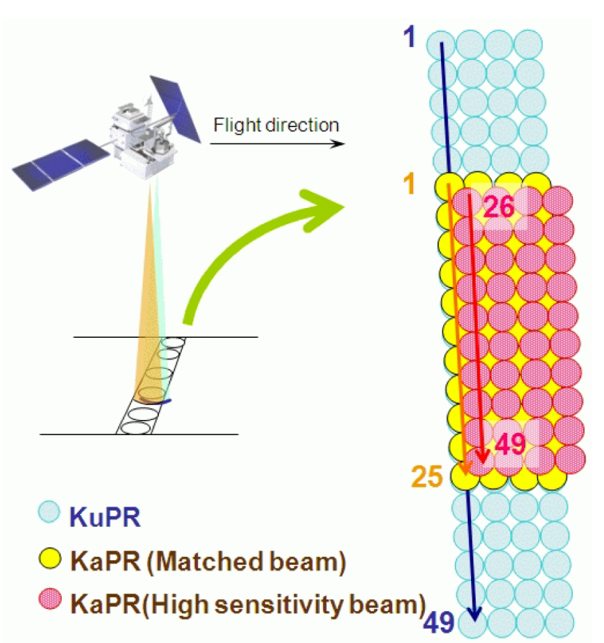
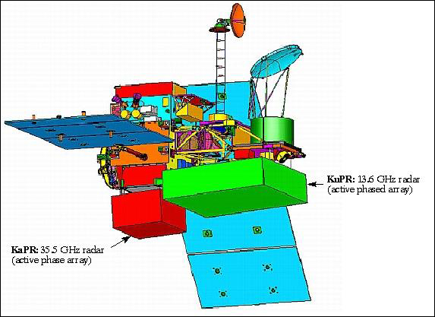
Dual-frequency Precipitation Radar (DPR)
Features | KuPR | KaPR
Frequency | 13.6 GHz | 35.5 GHz
Swath Width | 245 km | 120 km
Spatial Resolution | 5.2 km (Nadir @ 407 km)
Beam Width | 0.71° (Center Beam)
Beam Number | 49 Normal Scan, NS | 49: 25 in matched beams (MS) + 24 in interlaced scans (HS)
Min. measur. RR | 0.5 mm/h | 0.2 mm/h
Cross T. Scan Angle | ±17° | ±8.5°
3 Scan modes (NS, MS and HS)
prEs
Precipitation Estimated on Surface
2 product types (K-band only / Combined [DPR] Product)

Slide 20

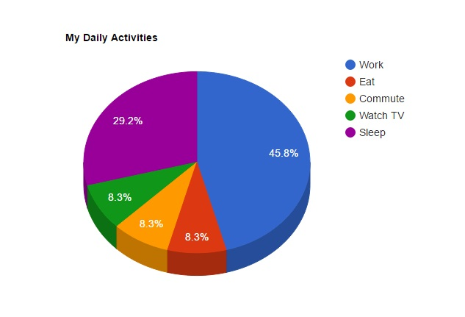

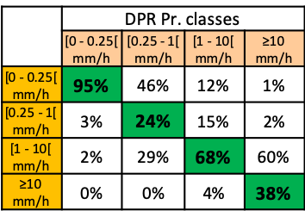

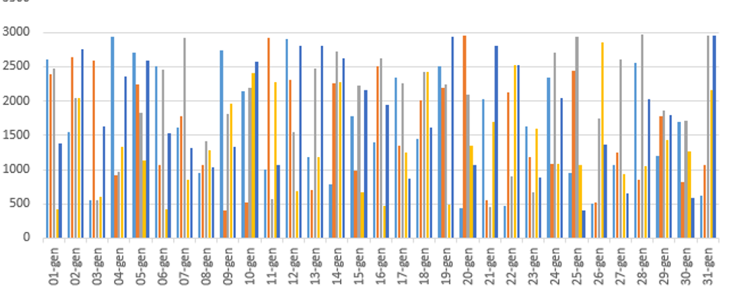
Comparison methodology over Africa
Intersection [temporal and spatial GPM vs NOAA/METOP and MeteoSat acquisitions]
Downscaling [regular grid 0.5°]
Comparison [pixel-based]
Results
Statistical scores
(events, monthly, seasonal, yearly)
For different geographical areas
(Africa, Europe, Ocean)
For different precipitation classes
(≥ 1 mm/h; ≥ 5 mm/h ; ≥ 10 mm/h)
For different surface types
(sea, land, coast)
20

Slide 21
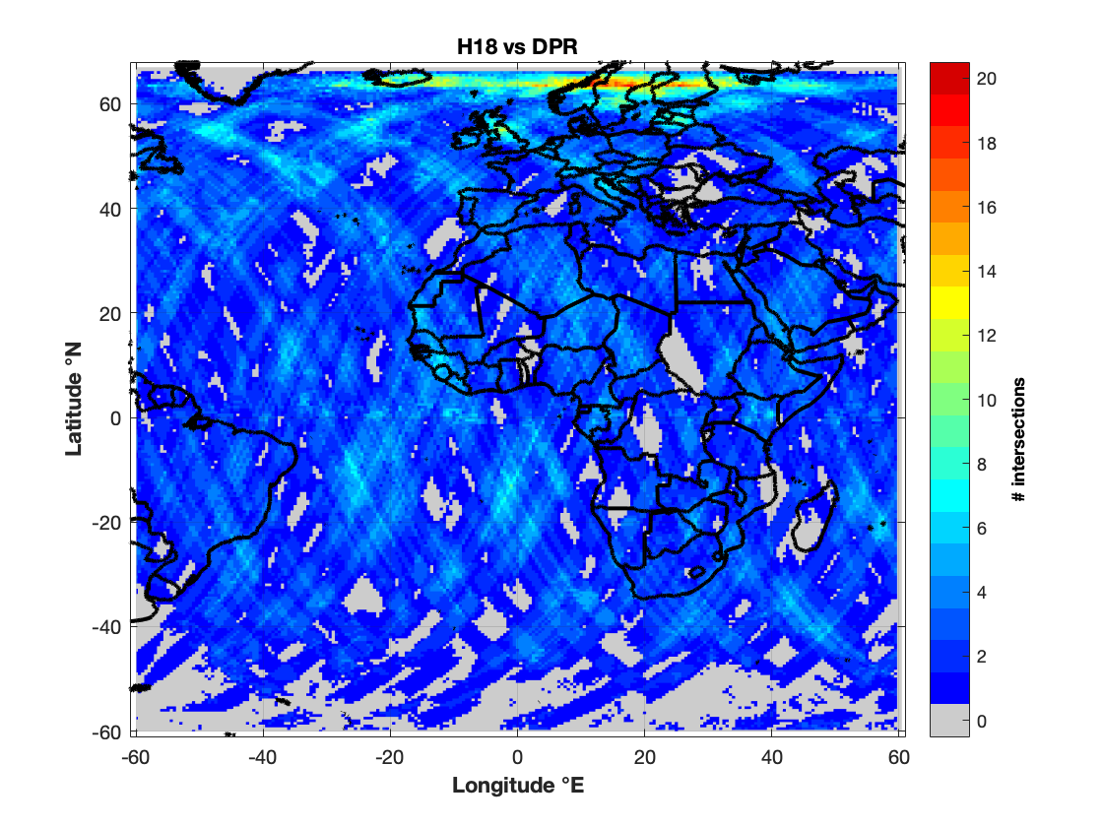
Summary results over Africa
Full validation results available on ORR report
Comparison results over 12 months (2017-2018)
H18 (P-IN-ATMS) is OPERATIONAL since 20/02/2020

Slide 22
Summary results over Africa
FSE=108%
Full validation results available on ORR report
Comparison results over 12 months (2017-2018)
H18 (P-IN-AMSU) is OPERATIONAL since 20/02/2020

Slide 23

Conclusion
Quality assessment service monitors the progress in product quality (OR)
ORR aimed to assess the readiness to deliver a product (-> operational or pre-operational)
Products successfully reviewed are available to end-users (EUMETcast, FTP)
Validation over Europe respect to ground precipitation data as reference
Comparison over Africa respect to DPR products (AS 2017)
FSE score is an indicator of how good a product is for users' purposes (User Requirement)
All operational precipitation products fully satisfy the User Requirements (FSE% between target and optimal);

Slide 24

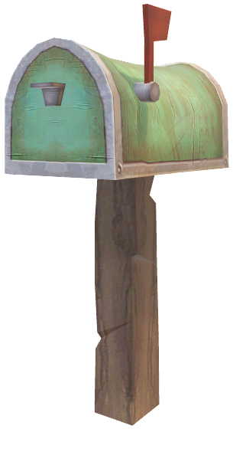

Thank you for your attention !
RENEWED
SOON
http://hsaf.meteoam.it/
Question?
Contact us!
Marco.Petracca@protezionecivile.it
Silvia.Puca@protezionecivile.it
@HydroSAF

